Slide 1
Modul 2
Datamatiker
Test

Slide 2
Test
Introduktion

Slide 3

Softwaretestning
Målet med at teste software: Finde fejl på en systematisk og effektiv måde
Ikke ved en tilfældighed, når programmet bliver brugt
Forsøge at få programmet/koden til at fejle
What is Software Testing & Why Testing is Important?
https://youtu.be/TDynSmrzpXw
Notes:
Running tests automatically helps to identify software regressions introduced by changes in the source code. Having a high test coverage of your code allows you to continue developing features without having to perform lots of manual tests.

Slide 4

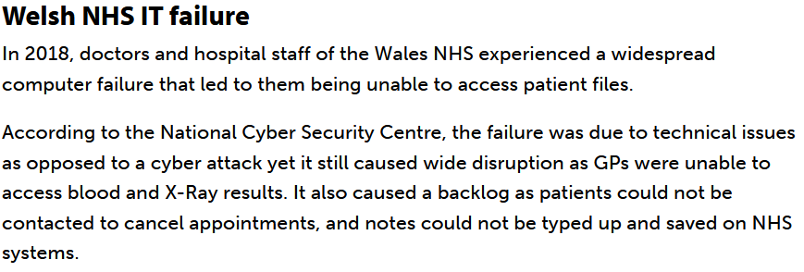
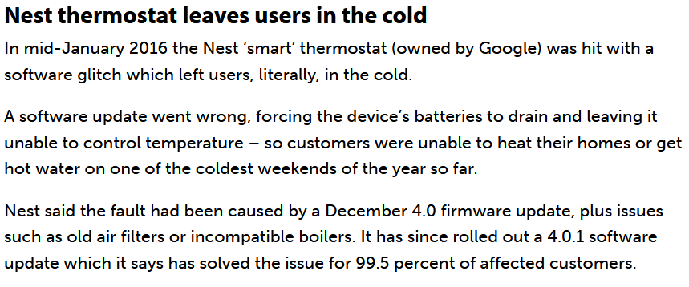
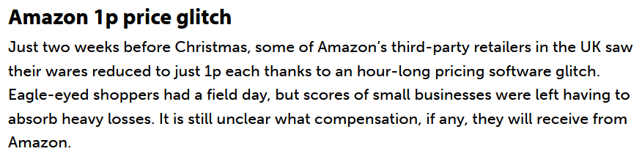
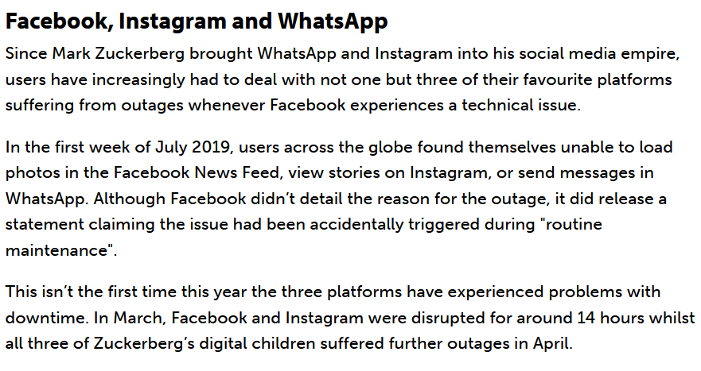
Eksempler på bugs
Top software failures 2019: British Airways, Facebook-Instagram-WhatsApp
https://www.computerworlduk.com/galleries/infrastructure/top-software-failures-recent-history-3599618/

Slide 5

Eksempler på bugs
Sundhedsplatformen: https://www.dr.dk/nyheder/tema/sundhedsplatformen
TDC – akuttelefon https://regionsyddanmark.dk/wm516969
https://twitter.com/akutberedskabet/status/1170805266557886465 https://twitter.com/akutberedskabet/status/1170705054040567809

Slide 6
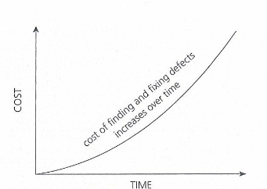
The Economic Dilemma
Jo før vi tester, jo bedre

Slide 7
Distribution of Resources
Test
Analyse
Build
Notes:
Test is a major part of system development. Time used for test in system development projects is approximately:
1/3 for requirement, analysis and design
1/3 for detailed design and construction
1/3 for test. Or is this only as it should be in an ideal world?

Slide 8
Type of Errors
Syntax errors:
while (x {}
Semantic errors:
Accessing non-existing variables/fields
true * 2 (type error)
Logical errors:
The program/code computes the wrong answer
Notes:
Errors of the two former kinds are relatively trivial: the Java compiler javac will automati-
cally discover them and tell us about them.
Logical errors (the third kind) are harder to deal with: they cannot be found automatically, and it is our own responsibility to find them.

Slide 9
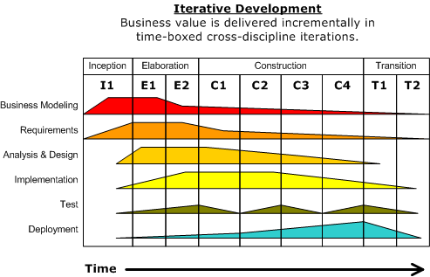
Test i UP
Test skal udføres under hele udviklingsprocessen
Kontinuerlig bekræftelse af kvaliteten af hver artefakt, aktivitet og delaflevering

Slide 10
Test i UP
Finde og dokumentere fejl i softwaren
Give generel tilbagemelding om den opfattede kvalitet af softwaren
Validering af om softwaren gør det, den er designet til
Validering af om softwaren fungerer, som det er krævet
Bevise validiteten af de formodninger, der er angivet i design og kravsspecifikationerne

Slide 11
V model
Idea
Operational system
User requirements
System requirements
Global design
Detailed design
Implementation
Component test
Integration test
System test
Acceptance test
Notes:
The V-Model demonstrates the relationships between each phase of the development life cycle and its associated phase of testing. Planning and executing of the test takes place in opposite time directions. The V-model may be considered an extension of the waterfall model. Instead of moving down in a linear way, the process steps are bent upwards after the coding phase, to form the typical V shape. The horizontal and vertical axes represents time or project completeness (left-to-right) and level of abstraction (coarsest-grain abstraction uppermost), respectively.

Slide 12
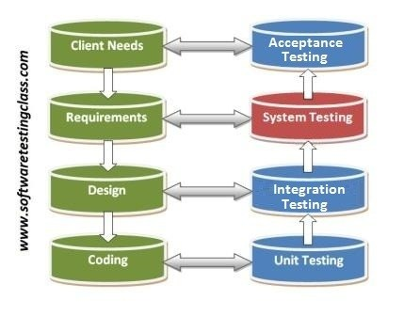
Testhieraki

Slide 13
Testfaser
Design
Specifications/
Interactions
diagrams
Use- Cases /
System-events
Other requirements / Quality
Use-cases
Operation
Component
test
Performance
test
Integration test
System
test
Accept test
Installation
test / Live test
Components and modules
are integrated
Full functional system with external interfaces
Verified and
validated
system
Accepted
system
Component
test
Delivered system
in use
Components
are tested
Test of operation
Released from development
Notes:
Witch brings us to the phases and how they relate.

Slide 14
Testplan
Et dokument, der beskriver:
anvendelsesområdet, fremgangsmåden, ressourcerne og tidsskema for de planlagte testaktiviteter.
Fx:
Features der skal testes
Testopgaver der skal udføres
Medarbejdere som skal udføre opgaverne
Testmiljø
Det er en oversigt og testplanlægningsprocessen.
Læs mere detaljeret om testplan: http://softwaretestingfundamentals.com/test-plan/

Slide 15
Test Plan
Master Testplan: Et dokument der I detaljer beskriver hvordan testene planlægges og hvordan det skal håndteres på tværs af de forskellige testniveauer [det er muligt at finde online skabeloner].
Fase Testplan: En testplan der typisk adressere en testfase/-niveau
Unit-testplan
Integrationstestplan
Systemtestplan
Accepttestplan
Notes:
The test model contains test cases that are often derived directly from use cases. Testers perform black-box testing using the original use case text.
http://tryqa.com/what-are-master-test-plans-level-test-plan-examples-when-to-use/

Slide 16
Teori
Systemtest

Slide 17
System Testing
Check the behavior of a complete and fully integrated software product based on the software requirements. The main focus of this testing is to evaluate Business / Functional / End-user requirements.
This is black box type of testing where external working of the software is evaluated with the help of requirement documents & it is totally based on Users point of view. For this type of testing do not required knowledge of internal design or structure or code.
First System Integration Testing is completed then System Testing.
In the integration testing testers are concentrated on finding bugs/defects on integrated modules. But in the Software System Testing testers are concentrated on finding bugs/defects based on software application behavior, software design and expectation of end user.

Slide 18
Why System Testing is Important:
Tested as a whole: In Software Development Life Cycle the System Testing is performed as the first level of testing where the System is tested as a whole.
Testing of Functional Requirements: In this step of testing, check if the system meets the functional requirements or not.
Architecture: System Testing enables you to test, validate and verify both the Application Architecture and Business requirements.
Production like environment: The application/System is tested in an environment that particularly resembles the effective production environment where the application/software will be finally deployed to.
Generally, a separate and dedicated team is responsible for system testing. And, System Testing is performed on the staging server which should be similar to the production server. So this means you are testing software application as good as the production environment.

Slide 19
Entry Criteria for System Testing:
Unit Testing should be finished.
Modules must be fully integrated and testet.
Development is completed.
Testing environment is available for testing (similar with Staging environment)

Slide 20
Functional Testing at System Level
System Testing focuses on user-visible actions and user-recognizable output from the system.
Focus on requirements
functional
non-functional
Later in the course(e.g. usability)

Slide 21
Functional Requirements (UP -> Use Cases)
Establish and maintain agreements with the customers and other stakeholders on what the system should do
Provide system developers with a better understanding of the system requirements
Define the boundaries of the system
Provide a basis for planning the technical contents of iterations
Provide a basis for estimating the cost and time to develop the system

Slide 22
Test Cases
A test case is a set of test inputs, execution conditions, and expected results, developed for a particular objective
To exercise a particular program path or verify compliance with a specific requirement.
To identify and communicate conditions that will be implemented in test.
https://www.youtube.com/watch?v=BBmA5Qp6Ghk&feature=youtu.be
Notes:
Although few actually do it, developers can begin creating test cases as soon as use cases are available, well before any code is written.
Test cases are necessary to verify successful and acceptable implementation of the product requirements (use cases).

Slide 23
Test Cases
Test cases are key to the process because they identify and communicate the conditions that will be implemented in test and are necessary to verify successful and acceptable implementation of the product requirements.
They are all about making sure that the product fulfills the requirements of the system.

Slide 24
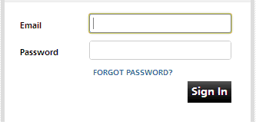
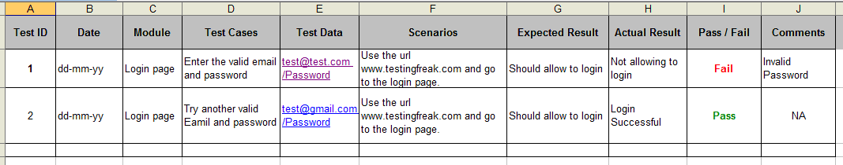
Example test cases for validation of email field on login page
Source: http://testingfreak.com/test-case/

Slide 25
Test Cases Generation at System Level
At System Level we want to verify compliance with system requirements.
In UP system functional requirements are defined by Use Cases.
Test Cases identify and communicate the conditions that will be implemented in test and are necessary to verify successful and acceptable implementation of the system requirements.
We can generate Test Cases from the Use Cases.
Note: Use Cases can be written too general
So when we test, we need to be more precise on the behavior of the systems, for example referring to the login page, can the system accept passwords of just one letter ?

Slide 26
Test Cases Generation at System Level
The most important part of a Use Case for generating Test Cases is the flow of events.
The two main parts of the flow of events are:
basic flow of events
alternate flows of events
The basic flow of events should cover what normally happens when the Use Case is performed.
The alternate flows of events covers behavior of an optional or exceptional character relative to normal behavior, and variations of the normal behavior.

Slide 27
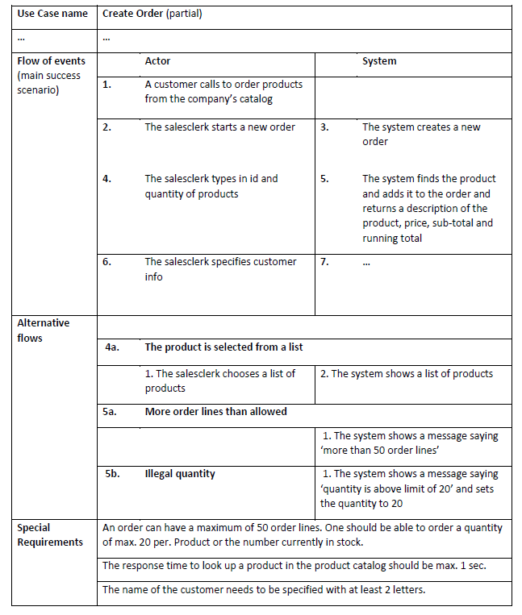
Such as non-functional
requirements or other
requirements not mentioned
in the Use Case description
it self

Slide 28
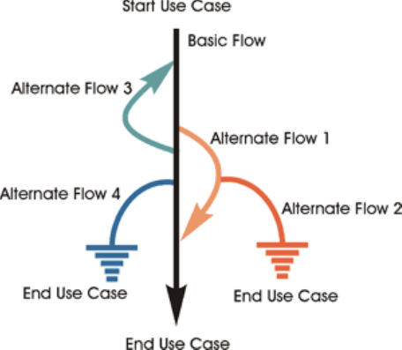
Use-Case Scenario
E.g.
Scenario 1: Basic Flow
Scenario 2: Basic Flow, Alternate Flow 1
Scenario 3: Basic Flow, Alternate Flow 1, Alternate Flow 2
A Use-Case Scenario is an instance of a use case, or a complete "path" through the use case.

Slide 29
Generating Test Cases from Use Cases
Process for generating Test Cases from a Fully Dressed Use Case:
For ‘each’ use case, generate a full set of Use-Case Scenarios.
For each Scenario, identify at least one Test Case and the conditions that will make it "execute."
For each Test Case, identify the data values with which to test.

Slide 30
Test
Eksempel

Slide 31
Example
Consider a Use Case: University Course Registration
The basic flow is something like:
Logon
Create a schedule
Obtain course information
Select courses
Submit schedule
Display completed schedule

Slide 32
Example (continued)
List of alternate flows:
1. System cannot identify the student
2. Registration aborted before the schedule is finished
3. Unfulfilled prerequisites, course full, or schedule conflicts
4. Course catalog system unvailable
5. Course registration closed
Notes:
Alternate flows always specify where they start in the basic flow and where they go when they end.

Slide 33
Steps in Generating Test Cases
Identify test case scenarios
Generate test cases for each scenario
Identify data values to test

Slide 34
Step 1. Generate Scenarios
Read the Use-Case textual description and identify each combination of main and alternate flows -- the scenarios -- and create a Scenario Matrix
Notes:
Alternative flows can be nested (basic flow -> A1 -> A2)

Slide 35
Step 2. Identify Test Cases
Analyze the Scenarios and review the Use Case textual description to identify Test Cases -> find the conditions or data elements required to execute the various scenarios
This specific matrix shows what conditions are being tested for each Test Case.
Do not yet supply data values but use:
V for valid
I for invalid
n/a when it is not necessary to supply a
data value
By looking at the Vs and Is you should
determine whether you have identified a
sufficient number of Test Cases.
Notes:
Once the full set of scenarios has been identified, the next step is to identify the test cases. We can do this by analyzing the scenarios and reviewing the use case textual description as well. There should be at least one test case for each scenario, but there will probably be more. For example, if the textual description for an alternate flow is written in a very cursory way, like the description below,
3A. Unfulfilled Prerequisites, Course Full, or Schedule Conflicts
then additional test cases may be required to test all the possibilities. In addition, we may wish to add test cases to test boundary conditions.

Slide 36
Step 3. Identify Data Values to Test
Substitute actual data values for the Is and Vs.

Slide 37
Øvelse

Slide 38
Gruppeøvelse
Modul_2_Exercises.pdf
Heumann_Generating_Test_Cases_From_Use_Cases.pdf

